Slide 1
JUNE 2026
Clare County
Welcome to Summer, 4-H Families!
As the school year ends, we want to wish all our 4-H families a great start to summer! Congratulations to our 2026 graduates, we are so proud of your accomplishments and wish you the best in your next chapter.
With kids out of school, this is an exciting time as many of our members begin focusing on their Home Arts and Animal Science projects. From caring for animals to creating and learning new skills, there is so much happening as we prepare for fair season.
We look forward to seeing all the hard work, creativity, and dedication our youth will showcase in the months ahead. Wishing everyone a fun, safe, and successful summer!
As we get ready for fair, we appreciate all the volunteers who help, especially in the Milk Booth! To keep our 4-H youth safe, all volunteers must complete the Volunteer Central process before helping. Thank you for supporting our program and making fair a success!
Warmly,
Renee Sanders
Renee Sanders
4-H Coordinator
MSU Extension
4-H
225 W. Main Street
Harrison, Michigan
49625
(989) 539-7805
biselr@msu.edu
msue.county@county.msu.edu
Safety Day | 6-7-2026 | Clare County Fairgrounds
Camp Registration | 6-15-2026 | MSU Extension Office
4-H Council Meeting | 6-24-2026 | 6 pm | PMDL Clare Michigan
Cloverbud Show Registration | 6-28-2026 | MSU Extension Office
4-H Home Arts Auction Registration | July 1, 2026 | MSU Extension Office
Fair Forms | 7-1-2026| Clare County Fairgrounds
Fair Camping Fee Balance | 7-18-2026 | Clare County Fairgrounds
Cloverbud Show Registration link:
https://forms.microsoft.com/r/bSXtQHyB4E
4-H Home Arts Auction Registration link:
https://forms.cloud.microsoft/r/4s98s4xhWb
https://www.canr.msu.edu/county/

Slide 2

Preparing Youth to Be Beyond Ready Through 4-H Livestock Projects
June 6: Garden Geocache Event
Michigan 4-H Children's Gardens, East Lansing
Cache veterans and new enthusiasts are welcome at this geocaching adventure. Bring your picnic lunch and enjoy a day of caching in the gardens. Find new caches, trade travel bugs, explore the gardens and much more.
www.canr.msu.edu/events/garden-geocache
June 9: Online Extension Extras for Parents: Internet Safety
Online
Screens are everywhere, and children are spending more and more time in front of them. This session will discuss topics including steps to take to keep kids safe online, apps youth use and their safety, Michigan laws, and more.
www.canr.msu.edu/events/online-internet-safety-6-9-26
June 11: Adulting 101 – AI and You: Smart, Safe and Savvy
Online
As part of the Michigan 4-H Adulting 101 webinar series, this session will explore the basics of how artificial intelligence works, ways it can support you, and how to make smart decisions.
www.canr.msu.edu/events/ai_and_you
June 18: Pirate and Pixie Garden Party
Michigan 4-H Children's Gardens, East Lansing
Argh me mateys. Join a morning of swashbuckling fun! Go on a treasure hunt, making pixie dust, decorate an eye patch and more!
www.canr.msu.edu/events/pirate-and-pixie-garden-party
June 23: Digger Day
Michigan 4-H Children's Garden, East Lansing
Come to the garden and explore the world of diggers. Front- end loaders, dump trucks and back hoes – all of these tools help with projects both big and small in communities.
www.canr.msu.edu/events/digger-day
July 1: 4-H and FFA Livestock Judging State Contest
Farm Bureau Pavilion, East Lansing
Participants will demonstrate their livestock evaluation and selection skills, as well as improve communication and decision-making skills. Register by June 15.
www.canr.msu.edu/events/4-h-and-ffa-livestock-judging-state-contest-2026
4-H livestock projects provide powerful, real-world learning that helps youth become Beyond Ready for life, work and leadership. Caring for animals teaches responsibility, time management and problem solving, all of which are essential skills for future success. Through chores, recordkeeping and making informed decisions, youth practice accountability and perseverance.
Livestock projects also build confidence as members explain their work to judges, interact with buyers and demonstrate professionalism in the show ring. When volunteers encourage reflection, support goal setting, and help youth connect these experiences to life beyond the barn, young people begin to see how their efforts today prepare them for tomorrow. Are your project activities helping youth become Beyond Ready?
#BeyondReady

Slide 3

Register for the Michigan 4-H and FFA
State Livestock Judging Contest
Registration is now open for the Michigan 4-H and FFA State Livestock Judging Contest! Participants can demonstrate their livestock evaluation and selection skills, as well as improve their communication and decision-making skills at this fun statewide contest. The day will include both individual and team competition with classes of beef cattle, Boer goats, sheep and swine.
Contest divisions include:
4-H Juniors - 4-H youth ages 8-13 as of January 1
4-H Seniors - 4-H youth ages 14-19 as of January 1
FFA Junior High - FFA members that recently completed seventh or eighth grade
FFA High School – FFA members that recently completed grades 9-12
MLE - Youth ages 8-21 as of January 1 that are not a member of 4-H or FFA
Cloverbuds - 4-H youth age 7 as of January 1, non-competitive
While the dates for the contest no longer coincide with Michigan Livestock Expo (MLE), this contest does still count as an educational experience for the MLE Premiere Stockman Award. Registration is due by June 15. Find registration information at www.canr.msu.edu/events/4-h-and-ffa-livestock-judging-state-contest-2026.
MSU Extension honors 11 Michigan 4-H volunteers for 50 years of service in 2026
For the sixth year, MSU Extension is celebrating outstanding volunteers who have given a half-century of service to Michigan 4-H. These individuals have pledged their heads, hearts, hands and service to improving the lives of youth and their communities through Michigan 4-H for the past 50 years.
“We give thanks for every volunteer in our program,” said Quentin Tyler, director of MSU Extension. “Michigan 4‑H would not exist as it does today without the dedication of volunteers who generously share their gifts, and these 11 remarkable individuals in particular have been sharing their gifts for a half-century. We offer them our sincere and heartfelt appreciation for all they’ve done for our organization and Michigan 4-H’ers.”
The Michigan 4-H 50-year volunteers being recognized in 2026 are:
Kay Booth, Barry County
Joyce Goerge, Clinton County
Betty Groth, Cass County,
Beverly Koppelman, Monroe County
Gary Koppelman, Monroe County
Michael Lee, Osceola County
In recognition of their service, 50-year volunteers received a gift of appreciation from MSU Extension leadership, as well as a personal note of thanks. Tribute gifts in honor of any or all of these 4-H volunteers may be made to support 4-H at: https://mi4hfdtn.org/memorial-tribute-gifts/.
Deb Pincumbe, Ingham County
Linda Preston, Cass County
Peter Preston, Cass County
Kathy Williams, St. Clair County
Mary Yeomans, Midland County

Slide 4
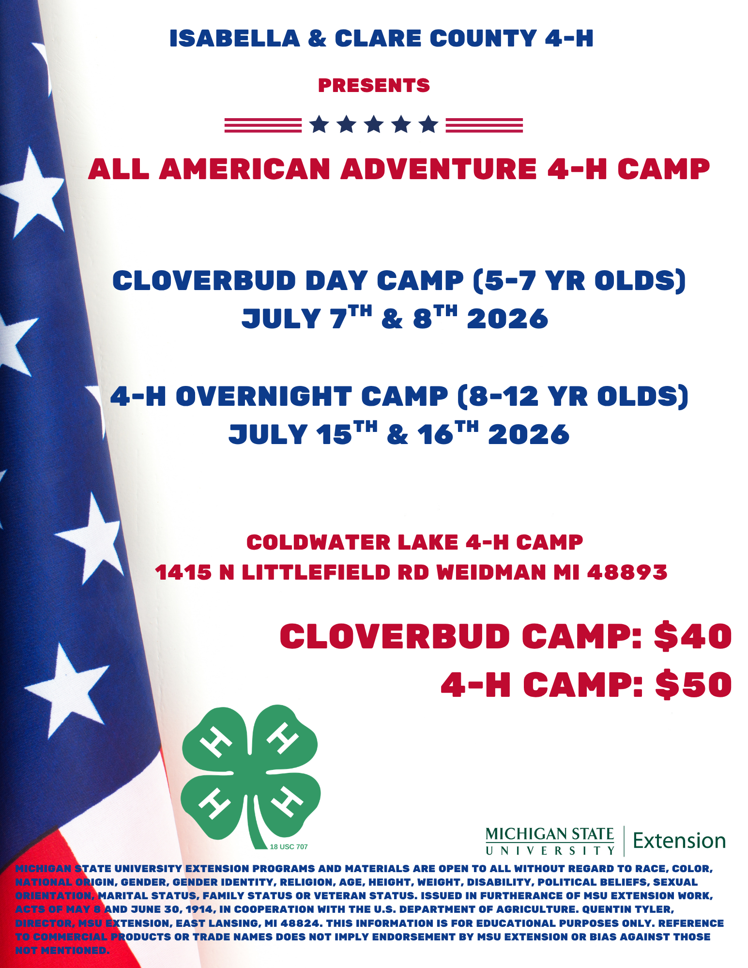

Clare County News
4-H Summer Camp Registration is OPEN!
Get ready for an All American Adventure at Coldwater Lake 4-H Camp!
Cloverbud Day Camp (ages 5–7)
July 7 & 8, 2026
4-H Overnight Camp (ages 8–12)
    July 15 & 16, 2026
From outdoor adventures and hands-on activities to making new friends and unforgettable memories—this is what summer is all about! 🌲🎣
Cloverbud Camp: $40
4-H Camp: $50
Don’t forget you can apply for a Make A Wish Scholarship.
Register here:
https://clareisabella20264hcamp.4honline.com
Register by June 15th
Spots will fill fast—don’t wait!
Leadership Possibilities
Are you 14–19 years old?
We are looking you!
Camp Councilors
Cloverbud Show Judges
Text Renee 231-735-0067
Clare County 4-H Council Higher Education Scholarship
We are so excited to celebrate this year’s 4-H Council Higher Education Scholarship winners: Hayley Neff, Thomas Dewey, Kerrigan Koch, Marlee Clark, and Lydia Bear!
These amazing young leaders have spent years growing through 4-H through leading clubs, mentoring younger members, volunteering in their communities, competing in projects, and making a difference wherever they go. From the barn to the fairgrounds to community events, they’ve truly shown what it means to learn by doing and give back along the way.
Each of them has left a positive mark on Clare County 4-H, and we couldn’t be more proud of all they’ve accomplished!
Congratulations on this well-deserved achievement, we can’t wait to see all the incredible things you’ll do next!

Slide 5
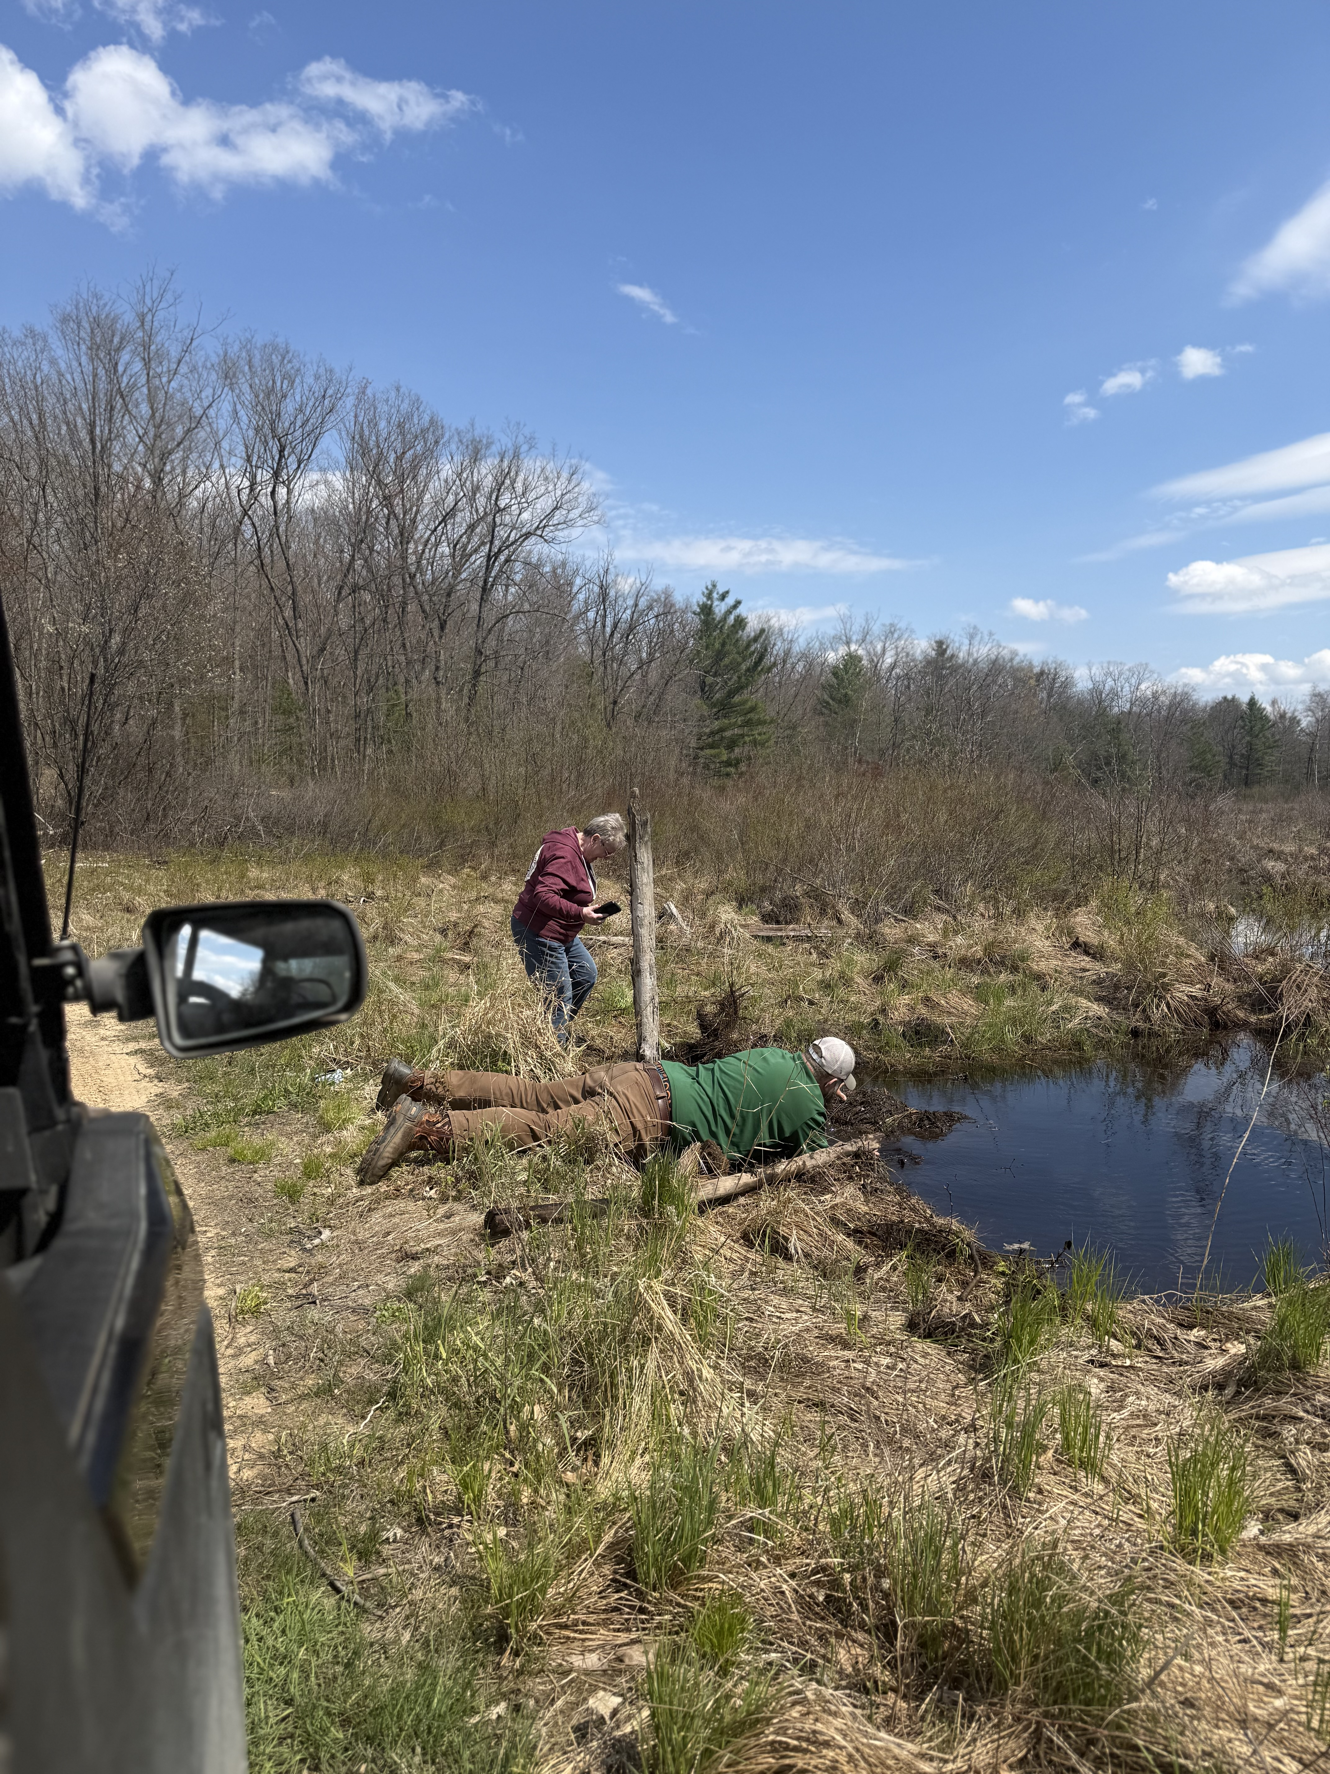
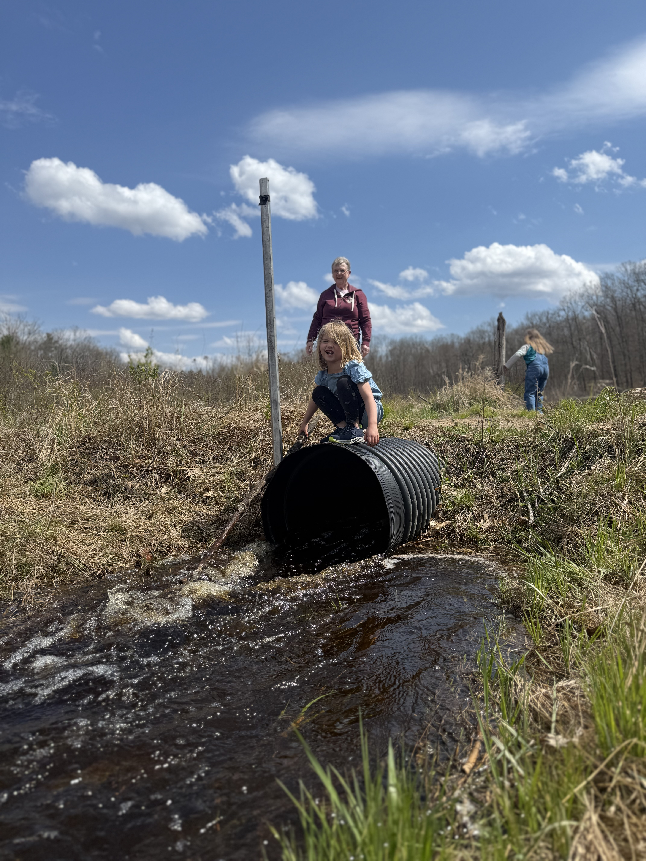
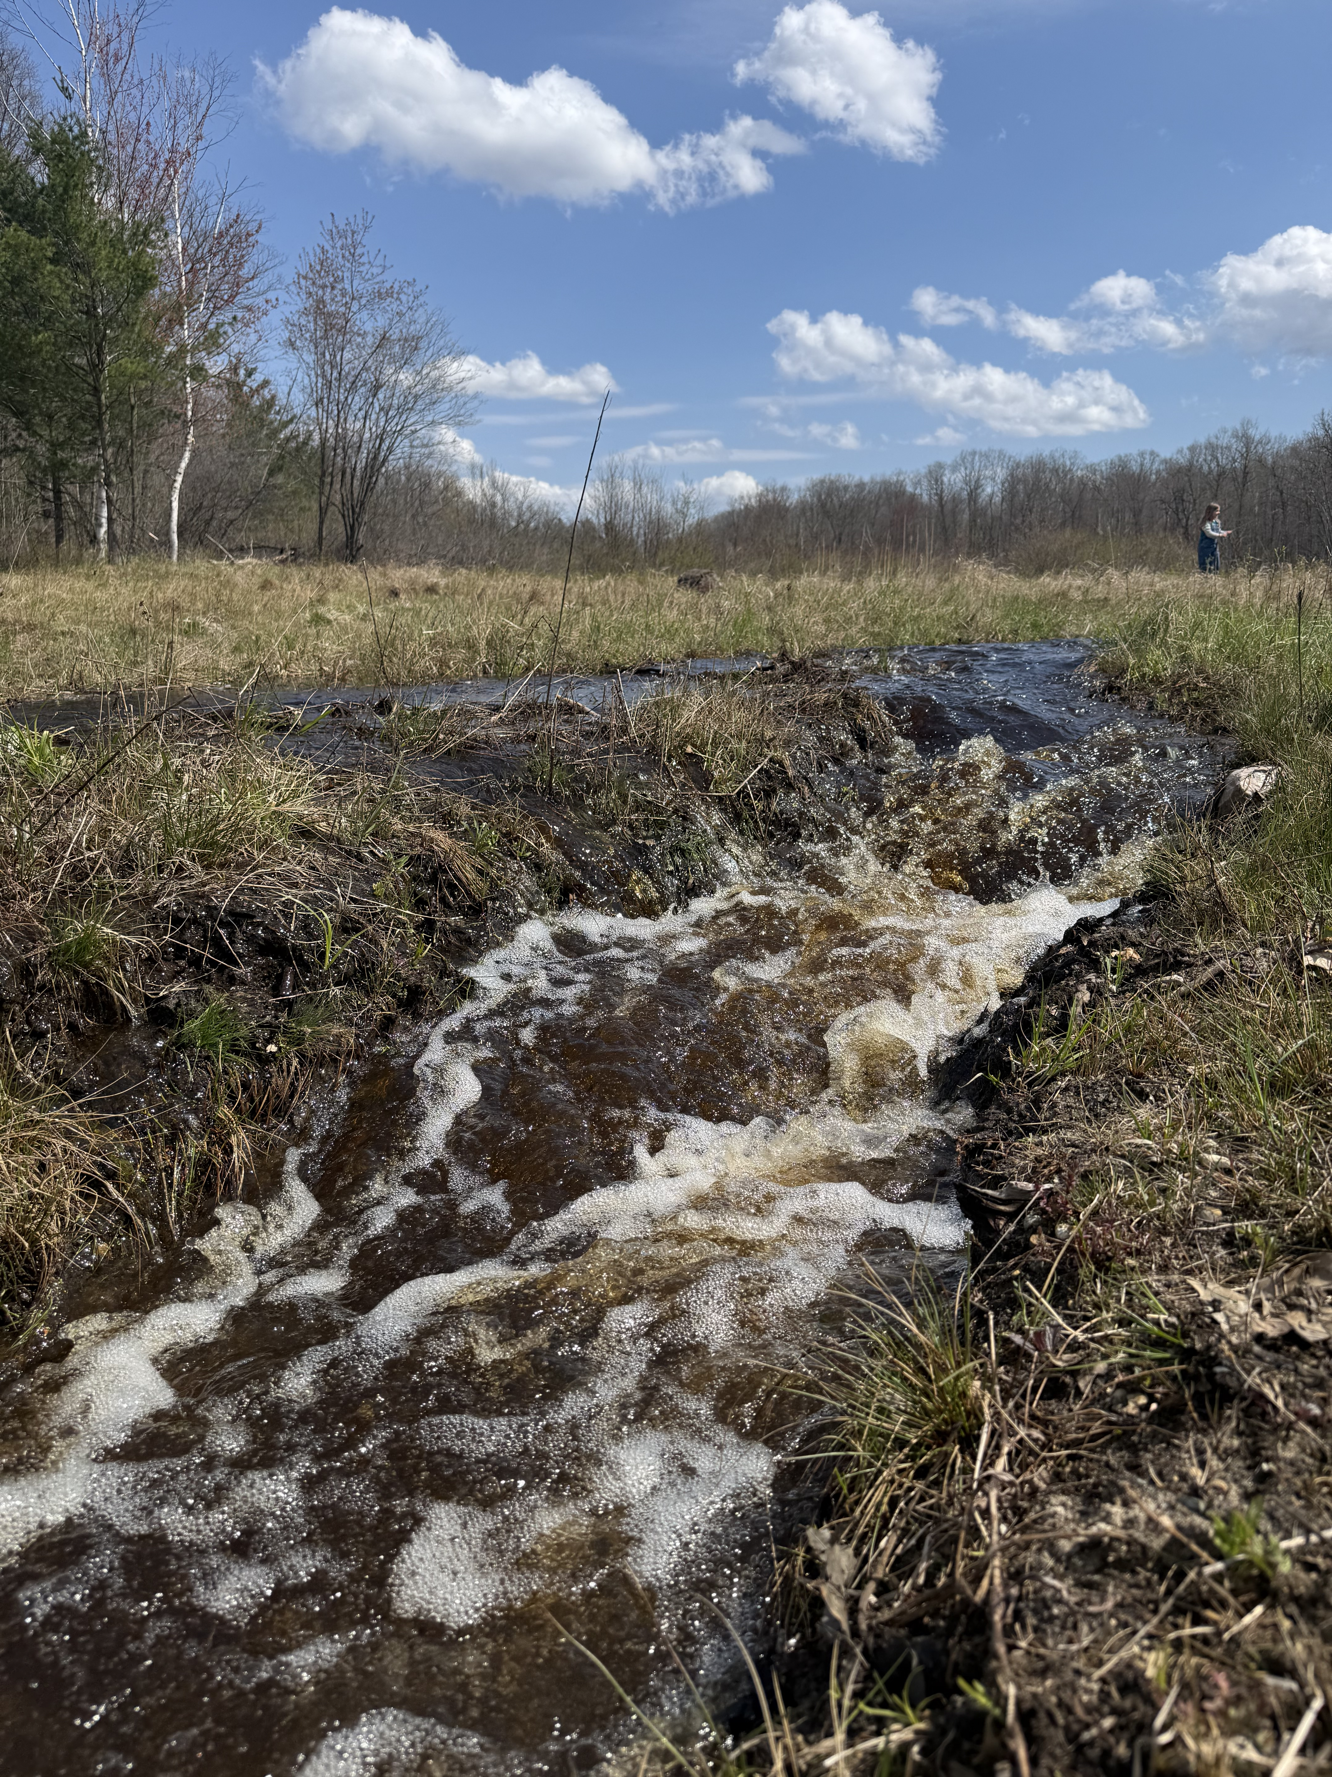
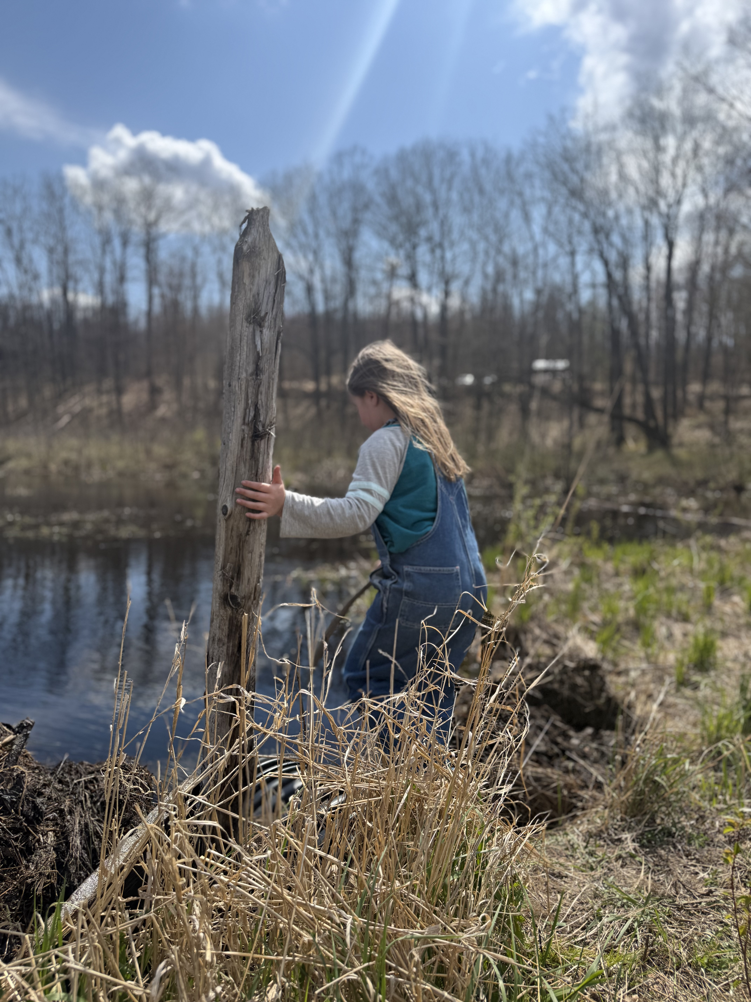
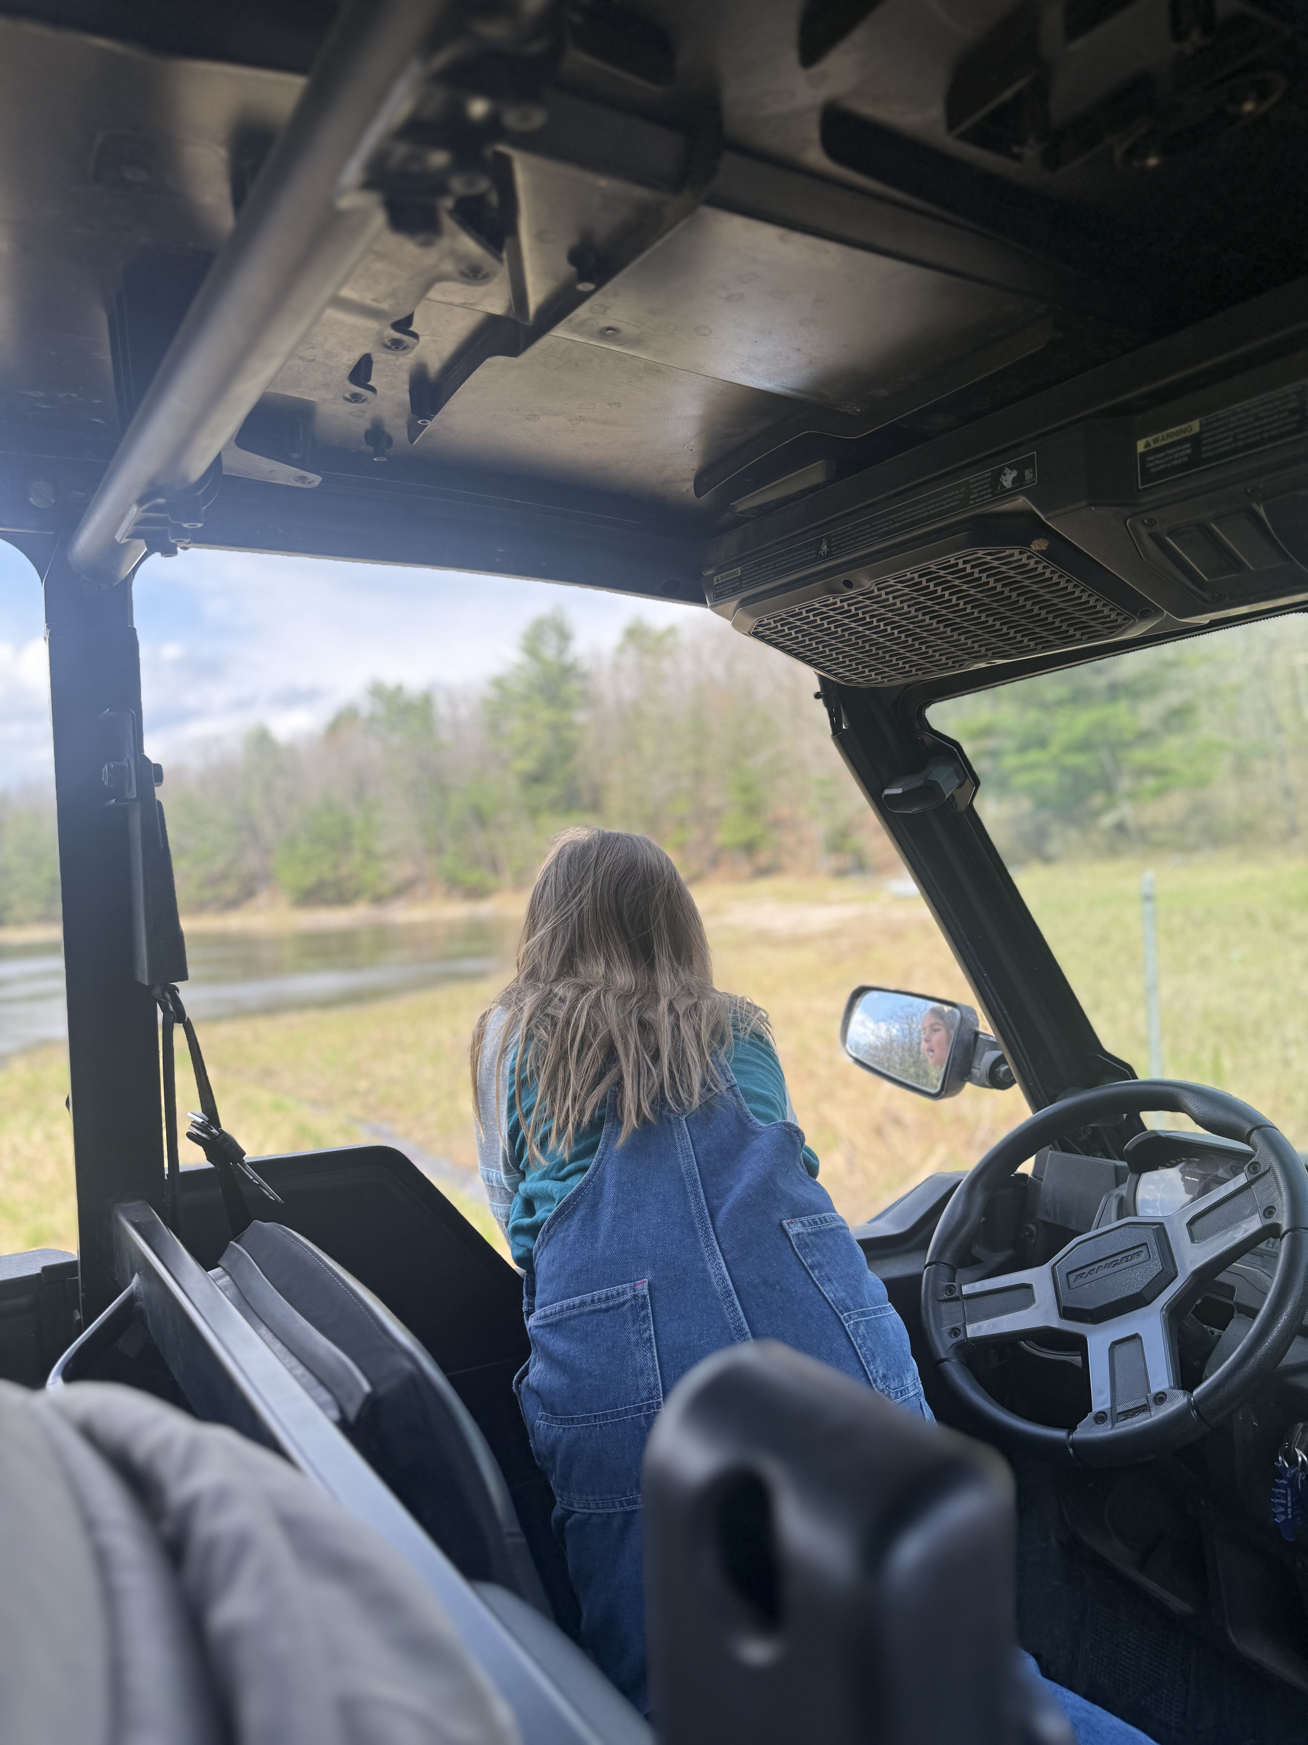
Hide N Hares 4-H Club.
On May 10, the Hide N Hares Club had a trail clean-up meeting at The Ranch.
Club Member Quote
We went to the 4-H ranch. My daddy cleared up the beaver dam, and I played in the water. We rode the side-by-side, We picked up the branches and cleaned up the trails. We had so much fun. ~Emily
Honor Club:
Submit your 4-H Club News, quote and pictures for next month’s newsletter.

Slide 6




4-H in the community

Slide 7
Clare County 4-H Council

Slide 8
Clare County 4-H Council

Slide 9
Mailing Panel
Clare County MSU Extension
225 W. Main Street
Harrison, MI 28625
Clare County
To learn more about activities happening in Clare County 4-H follow us on Facebook.
https://www.facebook.com/clarecounty4H

